Slide 1



Modeling with

Slide 2

The basics

Slide 3
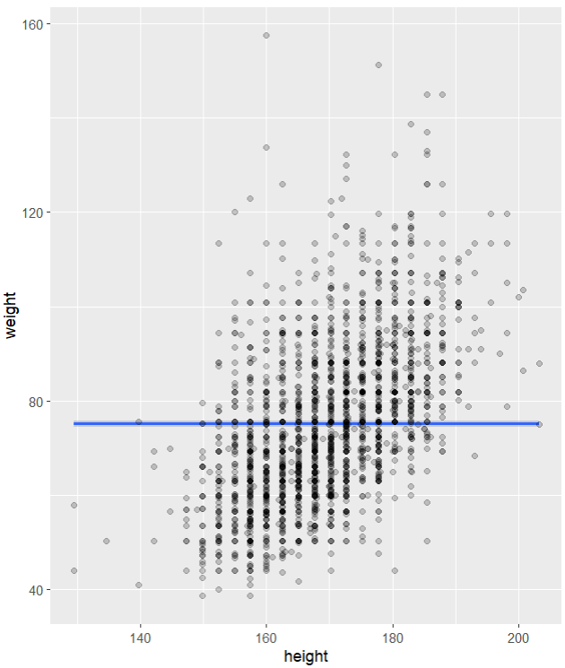
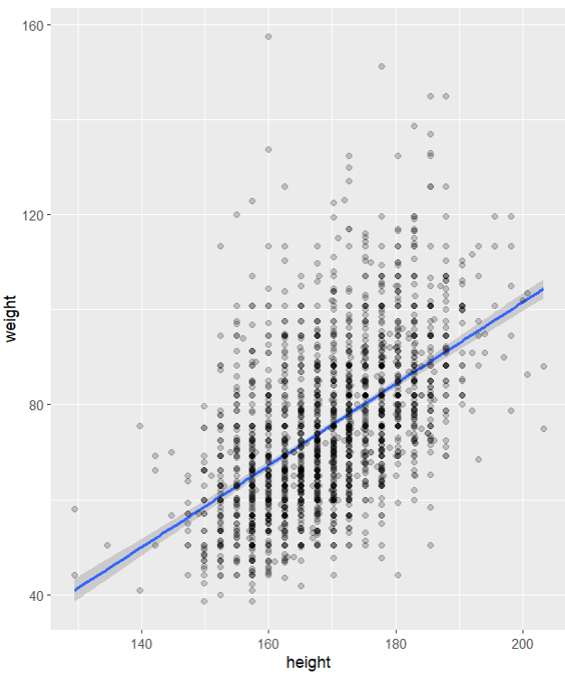
Modeling
Predicting a variable / testing whether a variable predicts another
Typical question: is model with predictor better than null model
vs.
3

Slide 4
Today
t.test(): Differences between groups
cor.test(): Correlation
lm(): Linear regression
4

Slide 5
Your Turn 1
In 02-Model-Exercises.Rmd:
Import ess_mini.RDS (code provided)
Filter for country == "GB" and save in ess_mini_UK variable
Create a boxplot showing working hours for males and females
Calculate mean working hours for males and females (NB: with missing data, need argument na.rm = TRUE in mean function)
05:00
5

Slide 6
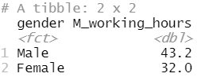
Getting ready for a t-test
ess_mini <- read_rds("data/ess_mini.RDS")
ess_mini_UK <- ess_mini %>% filter(country == “GB")
ess_mini_UK %>% ggplot(aes(x = gender, y = working_hours)) + geom_boxplot()
ess_mini_UK %>% group_by(gender) %>% summarise(M_working_hours = mean(working_hours, na.rm = TRUE))
6

Slide 7
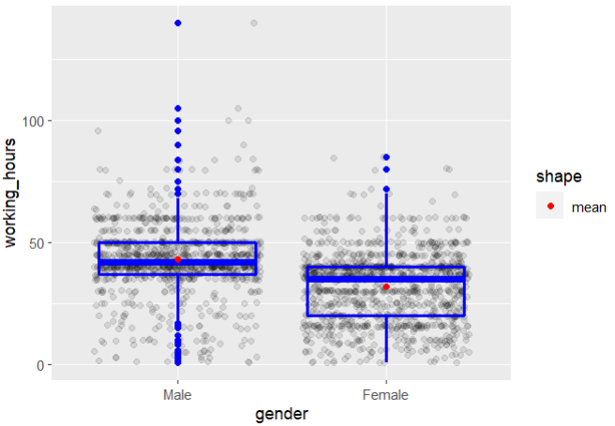
Show the data
Notes:
ess_mini_UK %>% ggplot(aes(x = gender, y = working_hours)) +
geom_jitter(alpha = .1) +
geom_boxplot(color = "blue", fill = NA, size = 1) +
stat_summary(color = "red", mapping = aes(shape="mean"), geom = "point", fun = mean)

Slide 8
t.test()
Runs a t-test
t.test(height ~ gender, data = ess_mini)
A formula that describes the model equation (read ~ as ‘predicted by’)
The data set
8

Slide 9
Your Turn 2
Run a t.test to see whether working hours differ significantly between males and females in the UK
Read through the result – what is reported?
02:00
9

Slide 10
R keeping it simple
t-tests in SPSS:
Check Levene’s test and remember interpretation
Read correct row and adjust reporting accordingly
t.test in R:
Welch correction reduces error when variances are unequal and makes no difference when variances are equal → Just use it always.
Turn it off with var.equal = TRUE argument
10

Slide 11
Output paradigms
SPSS: show everything you might need
R: show very little, provide object and specific functions to get more

Slide 12
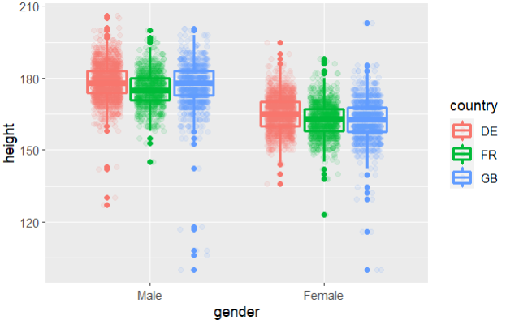
More than 2 groups
Notes:
ess_mini %>%
ggplot(aes(x = gender, y = height, color = country)) +
geom_jitter(alpha = .1, position = position_jitterdodge()) +
geom_boxplot(fill = NA, size = 1)

Slide 13
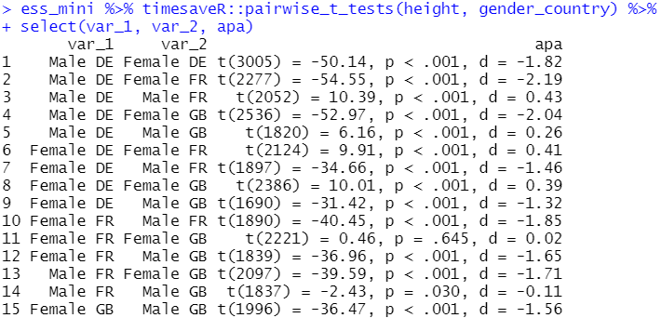
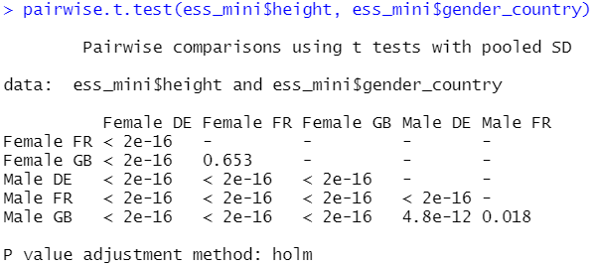
pairwise t-tests

Slide 14
pairwise_t_tests()
Runs a pairwise t-test
pairwise_t_tests(df = ess_mini, height ~ country)
The data set
Outcome
Groups
14

Slide 15
Your Turn 3
Test whether average happiness (happy) differs between countries.
Which country has the highest happiness?
What are the effect sizes?
03:00
15

Slide 16
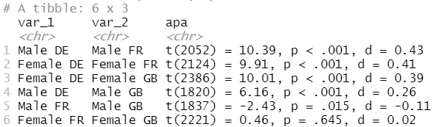
planned comparisons
Females across countries + Males across countries
ess_mini %>%
mutate(gender_country = paste(gender, country)) %>%
pairwise_t_tests(height, gender_country, p.adjust.method = "none") %>%
filter(str_detect(var_1, "Male") & str_detect(var_2, "Male") |
str_detect(var_1, "Female") & str_detect(var_2, "Female")) %>%
arrange(desc(abs(cohens_d))) %>%
select(var_1, var_2, apa)
Q: Are males in France significantly shorter than males in the UK?
Notes:
If using Bonferroni, case can be made for reporting unadjusted and changing threshold. Otherwise, use p.adjust() function.

Slide 17
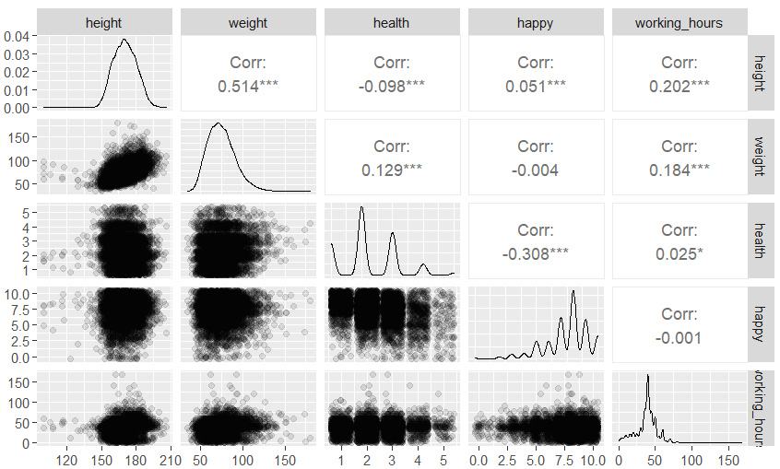
Getting ready to test correlations
pacman::p_load(GGally)
ess_mini %>%
select(where(is.numeric)) %>%
ggpairs(lower = list(continuous=wrap("points", position="jitter", alpha = .1)))
17

Slide 18
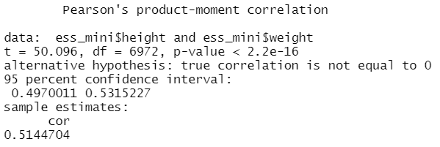
cor.test()
cor.test(ess_mini$height, ess_mini$weight)
Remember: $ means ‘take variable on right from dataset on left’
No data argument … need to pass two variables

Slide 19
Your Turn 4
Test whether happiness and health are correlated
Calculate both Pearson’s r and Spearman’s rho.
Remember ? to get details on arguments: ?cor.test
02:00
19

Slide 20
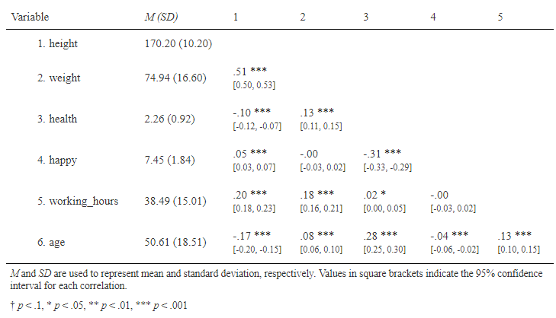
Get Table 1 in one command
ess_mini %>% cor_matrix() %>% report_cor_table()

Slide 21
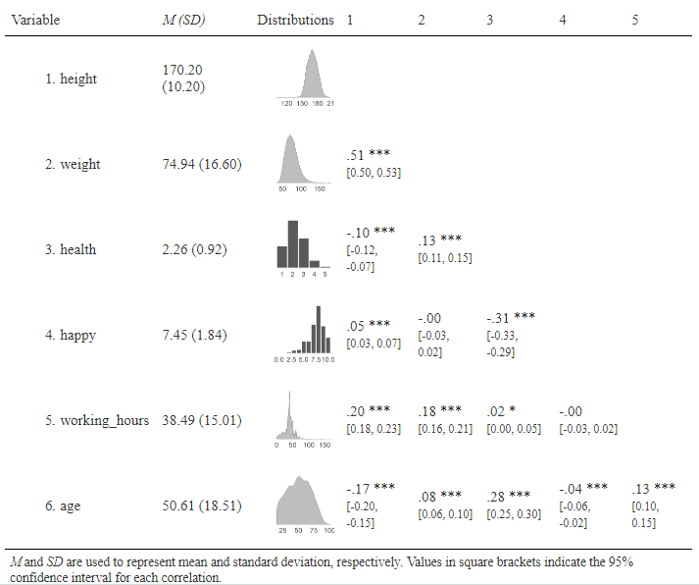
Get Table 1 in one command
…%>% report_cor_table(add_distributions = TRUE, data = ess_mini)
Notes:
ess_mini %>% cor_matrix() %>% report_cor_table(add_distributions = TRUE, data = ess_mini, plot_type = 11)

Slide 22
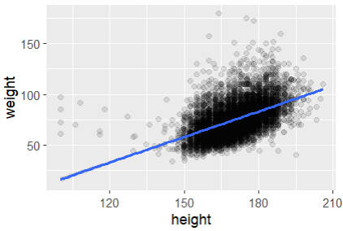
Finally, linear regression
ess_mini %>%
ggplot(aes(x = height, y = weight)) +
geom_jitter(alpha = .1) +
geom_smooth(method = "lm")

Slide 23
lm()
Estimates a linear regression model
lm(weight ~ height + gender, data = ess_mini)
A formula that describes the model equation (read ~ as ‘predicted by’, + as ‘and’)
The data set
23

Slide 24
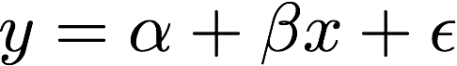


formulas
R formula only needs to include the response and predictors
y ~ x
y ~ x
Response
A tilde
The predictor(s)
24

Slide 25
Your Turn 5
Explore the relationship between body-mass index and self-reported health while controlling for gender
Create a bmi variable
Plot bmi vs health as a scatterplot, with color = gender and regression lines
Run the lm() model and pipe into summary()
What parts of the output can you interpret?
06:00
25

Slide 26
ess_mini <- ess_mini %>%
mutate(bmi = weight / (height / 100)^2)
summary(ess_mini$bmi)
Should have pre-specified exclusion criteria …
Notes:
Highest BMI recorded: at least 105 – so cannot really exclude here – lowest apparently 7.5

Slide 27
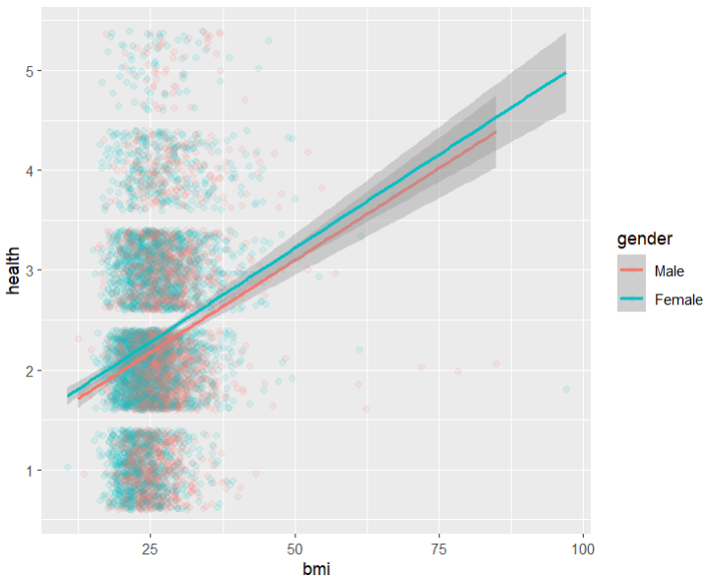
ess_mini %>%
ggplot(aes(x = bmi, y = health, color = gender)) +
geom_jitter(alpha = .1) +
geom_smooth(method = "lm")
Linear model with a five-point outcome?

Slide 28
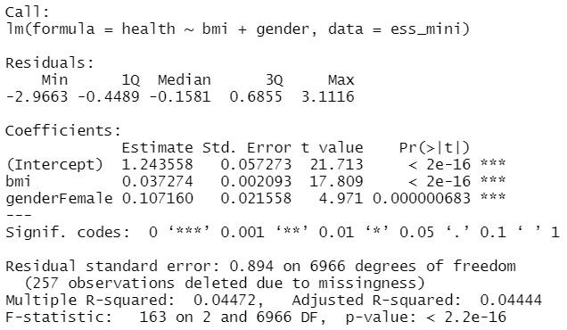
lm(health ~ bmi + gender, ess_mini) %>% summary()
Where is genderMale?
What does this mean?

Slide 29
lm(health ~ bmi + gender, ess_mini) %>% summary()
Predicted health for a male with bmi 25:
health = 1.24 + 0.04 * bmi + 0.11 * female = 2.24
Predicted health for a female with bmi 20:
health = 1.24 + 0.04 * bmi + 0.11 * female = 2.15
29

Slide 30
lm() with the pipe
ess_mini %>% lm(health ~ bmi + gender)
ess_mini %>% lm(health ~ bmi + gender, data = .) or
ess_mini %>% lm(health ~ bmi + gender, .)
. means: put piped data here
30

Slide 31
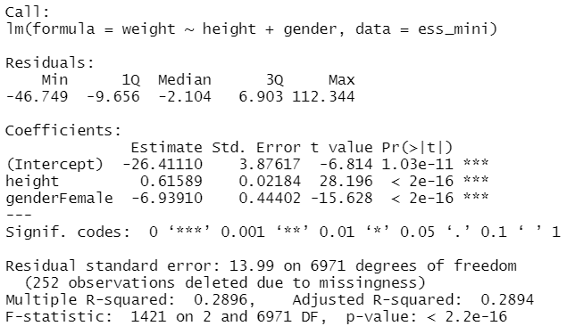
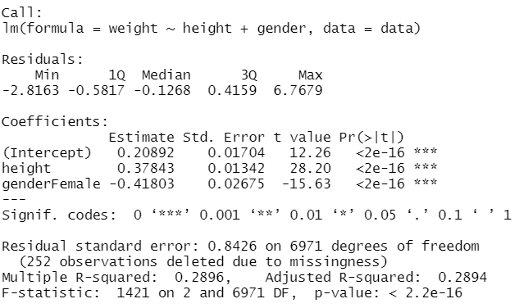
Getting standardised βs: lm_std()
lm_std(weight ~ height + gender, data = ess_mini) %>% summary()
31

Slide 32
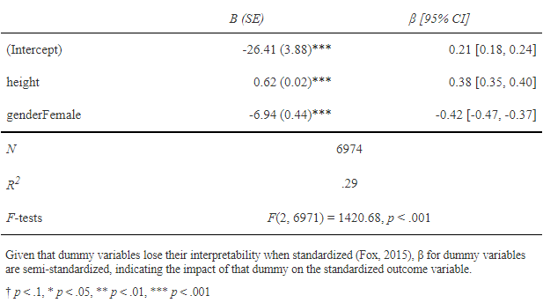
Reporting bs and βs
mod <- lm(weight ~ height + gender, data = ess_mini)
mod_std <- lm_std(weight ~ height + gender, data = ess_mini)
report_lm_with_std(mod, mod_std)
32

Slide 33
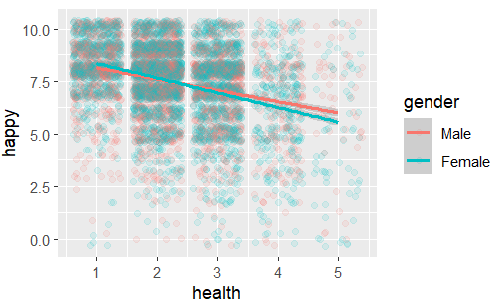
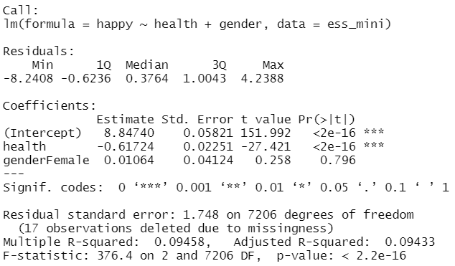
What’s the difference?
lm-model estimated by geom_smooth()
lm-model estimated by lm()

Slide 34
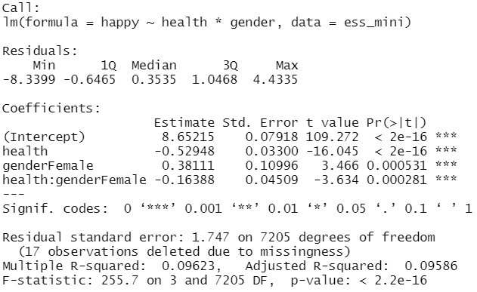
Interaction terms
lm-model estimated by geom_smooth()
lm-model estimated by lm()
NB: * instead of +

Slide 35
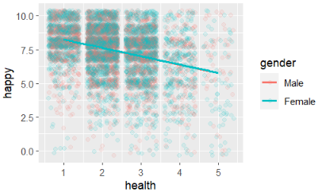
No interaction terms
lm-model estimated by moderndive::geom_parallel_slopes()
lm-model estimated by lm()

Slide 36
broom

Slide 37
broom
Turns model output into data frames
# install.packages("tidyverse")
library(broom)
Particularly helpful for comparing (and plotting) models
37

Slide 38
broom
Broom includes three functions which work for most types of models (and can be extended):
tidy() - returns model coefficients, stats
glance() - returns model diagnostics
augment() - returns predictions, residuals, and other raw values
38

Slide 39
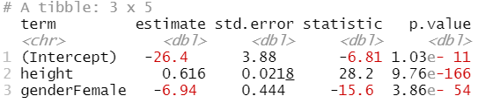
tidy()
Returns useful model output as a data frame
mod %>% tidy()
39

Slide 40
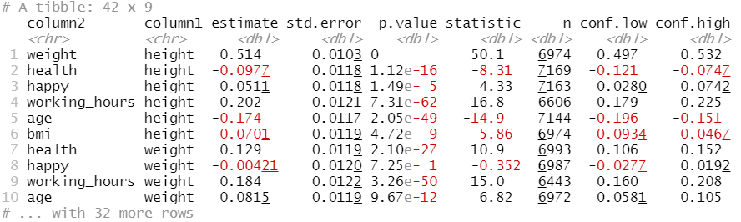
tidy()
Returns useful model output as a data frame
ess_mini %>% cor_matrix() %>% tidy()
40

Slide 41
glance
Returns common model diagnostics as a data frame
mod %>% glance()
41

Slide 42
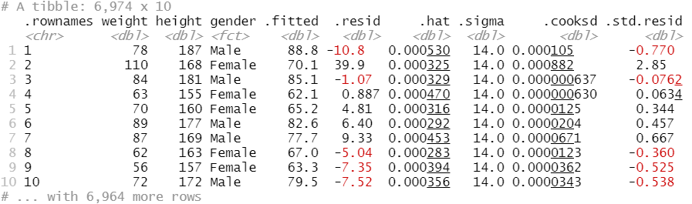
augment()
Relates model output to original data points
mod %>% augment()

Slide 43
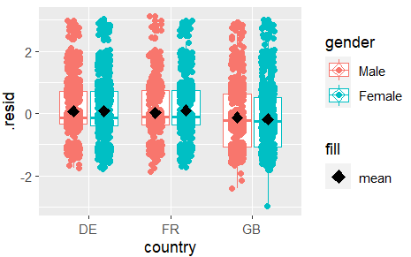
augment()
Allows to investigate residuals – here for health ~ bmi + gender
mod %>%
augment(data = ess_mini %>% drop_na(gender, bmi, health)) %>%
ggplot( …
Notes:
mod %>%
#Provide data so that residuals are added to full dataset,
#with variables not included in model present.
#Need to remove cases with missing data on variables in the model
augment(data = ess_mini %>% drop_na(gender, bmi, health)) %>%
ggplot(aes(x=country,y=.resid,col=gender)) +
geom_boxplot() +
geom_jitter(position=position_jitterdodge()) +
#Add means - note that mapping to a fixed value just adds a legend
stat_summary(mapping = aes(fill="mean"), geom = "point", fun = mean,
position = position_dodge(width = 0.75), size = 3, shape = 23) +
scale_fill_manual(values = "black")

Slide 44

performance
Thanks to Halley!

Slide 45
Your Turn 6
Save your health ~ bmi + gender lm-model into mod
Load the performance and see packages
Test the model with check_model(mod)
Discuss the results with a partner
Add a quadratic term to the model (+ I(bmi^2) in the formula)
Does that improve the model?
Does it make sense theoretically?
04:00
04:00
45
Notes:
ess_mini %>%
ggplot(aes(x = bmi, y = health, color = gender)) +
geom_jitter(alpha = .1) +
geom_smooth(method = "lm", mapping = aes(linetype = "linear")) +
geom_smooth(method = "lm", mapping = aes(linetype = "quadratic"), formula = y ~ x + I(x^2))
pacman::p_load(performance, see)
ess_mini <- ess_mini %>% mutate(bmi = weight / (height / 100)^2)
mod1 <- ess_mini %>% lm(health ~ bmi + gender, .)
check_model(mod1)
mod2 <- ess_mini %>% lm(health ~ bmi + I(bmi^2) + gender, .)
check_model(mod2)

Slide 46
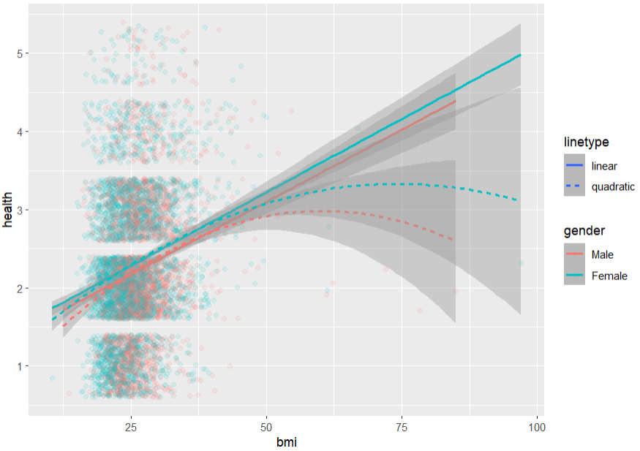
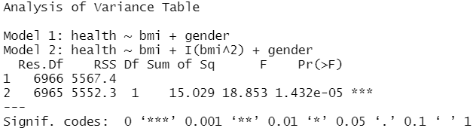
Compare models
Graphically (code in slide notes):
Statistically:
anova(mod_lin, mod_quad)
Notes:
ess_mini %>%
ggplot(aes(x = bmi, y = health, color = gender)) +
geom_jitter(alpha = .1) +
geom_smooth(method = "lm", mapping = aes(linetype = "linear")) +
geom_smooth(method = "lm", mapping = aes(linetype = "quadratic"), formula = y ~ x + I(x^2))

Slide 47
Modeling with

